Slide 1
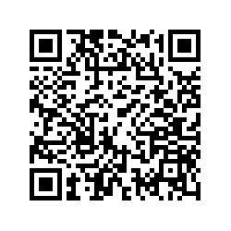
Higher Education: Maternity, Parenthood and Fertility in the UK
Inclusive study – add anything that you deem relevant such as your lived experiences of academia relating to parenthood, maternity leave, fertility, family leave, paternity leave and caring responsibilities.
Non-exhaustive list.
Welcome any experiences relevant to the project - positive, negative or neutral.
Anonymous survey LINK
UK focused study for now (funding constraints)

